Slide 1

Green Destinations HR
Employee KPIs & Insights Dashboards

Slide 2
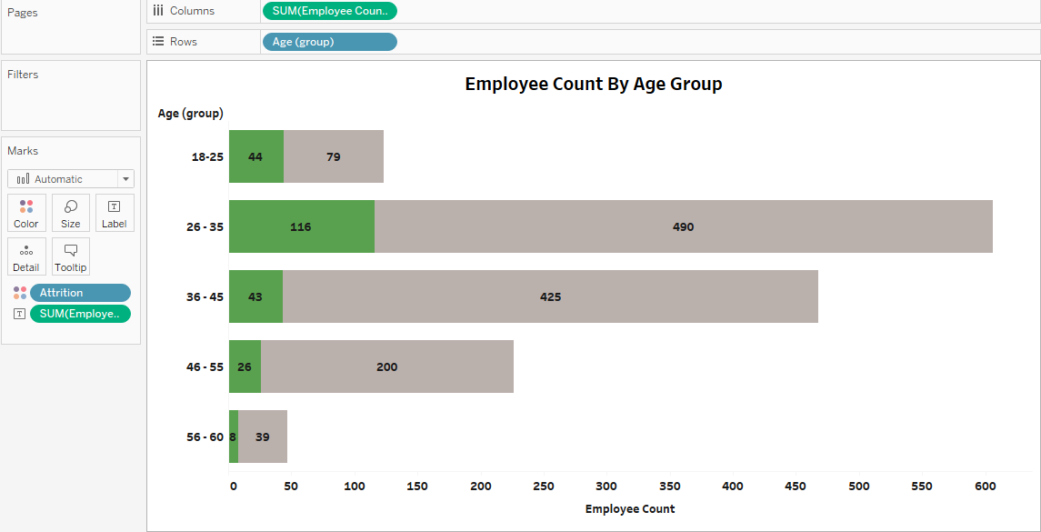
Ages groups 26 -35 have the highest attrition and largest workforce share too indicating mid career stability
rate followed by group from 18 -25 which has a smaller count but high attrition rate, suggesting challenges in retaining
early career talent.

Slide 3
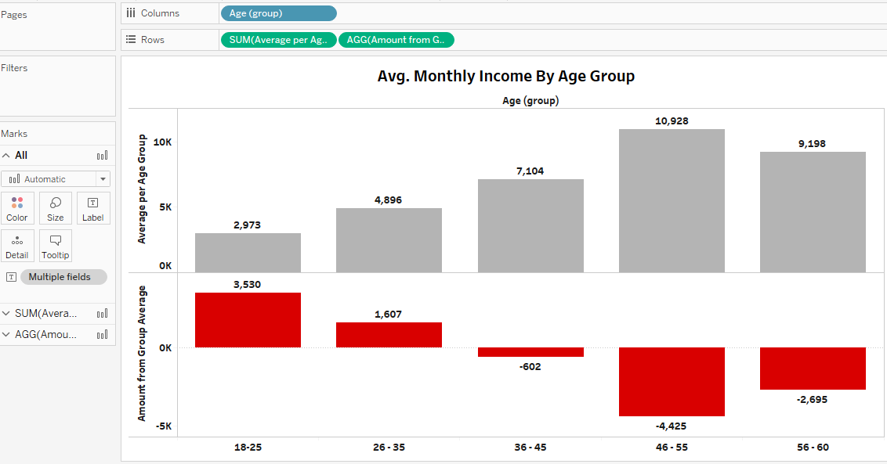
18 -25 group shows lower avg. income but higher attrition, indicating challenges in early career, 46-55 group shows
highest avg. monthly income reflecting career progression followed by 36-45 group .

Slide 4
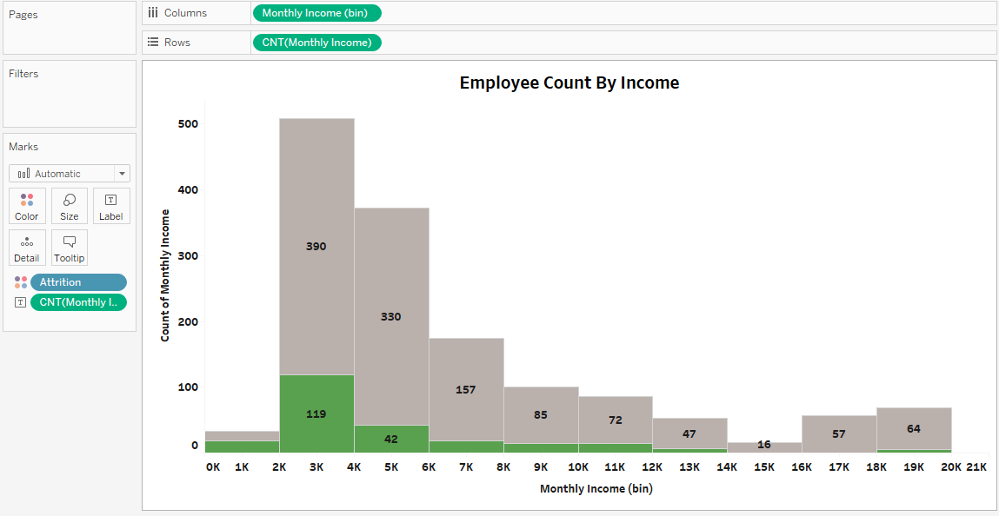
2k - 4k income group has highest workforce and highest attrition rate,
14k -16k group has the lowest workforce and least attrition.

Slide 5
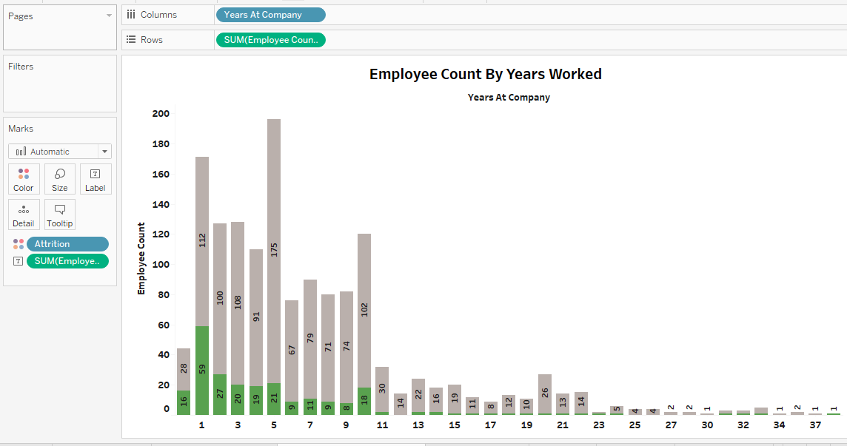
Employees who worked for a year have highest attrition rate, followed by 3-5 years span of employment,
Employee working for more than 10 years have the least attrition rate.

Slide 6
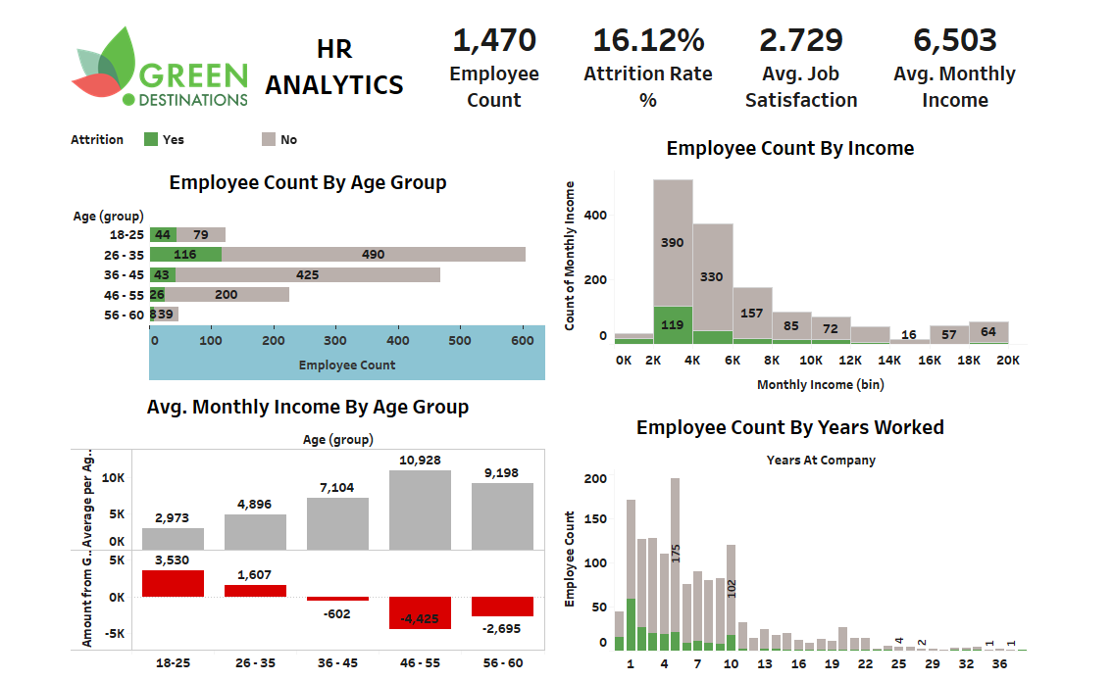
Complete Dashboard of analytics of employee count, monthly income aggregated along the years and
their attrition rate in the past and factors determined

